Slide 1
Exploiting Asymmetric Multi-Core Systems with Flexible System Software
Kallia Chronaki
Thesis Advisors: Rosa M. Badia Marc Casas
July 2018
PhD Thesis Defense

Slide 2
Overview
Introduction
Thesis background
Thesis motivation
Study of Asymmetric Systems
Scheduling in AMCs
TaskGenX
Thesis insights and Future directions

Slide 3
Introduction

Slide 4
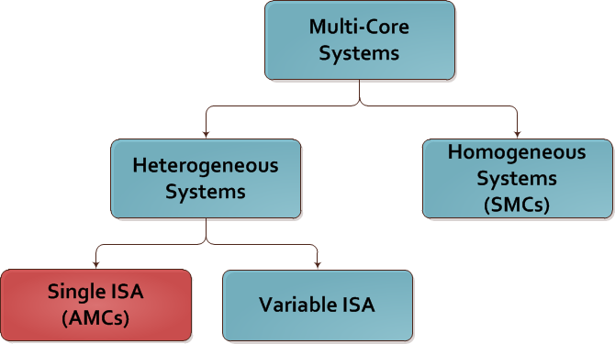
Multi-Core Systems

Slide 5
Asymmetric Multi-Core Systems (AMCs)
Multi-Core architectures with different types of cores
Used in mobile market and HPC
State of the art AMC: ARM big.LITTLE
Two types of cores
Big: out-of-order fast cores
Little: in-order simple cores and energy efficient

Slide 6
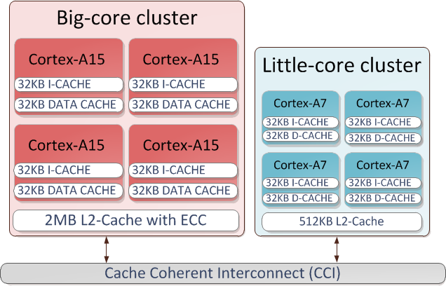
ARM big.LITTLE AMC System

Slide 7
Benefits and challenges of AMCs
Easy to program: no need of expressing functionality for multiple ISAs ✔
Energy efficient while providing high performance ✔
Load balancing ✘
Scheduling ✘

Slide 8
Addressing Challenges in AMCs with Task-Based Programming Models
void task1(int x, int y) { … } int main() { for(int i = 0; i <10; i++) for(int j = 0; j<10; j++) #pragma omp task in(i) out(j) task1(i, j); #pragma omp taskwait return 0; }
Ease programming of parallel applications
Task annotations with dependency tracking
Compiler + Runtime system
Dynamic scheduling and dependence analysis
Partially solves scheduling issues

Slide 9
Thesis Contributions
Extensive study of scheduling on Asymmetric Systems
Three asymmetry-aware scheduling techniques for task-based programming models
A HW-SW proposal to improve performance of task-based programming models

Slide 10
Study of Asymmetric Systems

Slide 11
Evaluation of Scheduling Approaches
Static threading
Application-based thread static scheduling
GTS
Global Task Scheduler: state-of-the-art OS scheduler for AMCs
Task-based
OmpSs programming model
K. Chronaki et.al.
POSTER: Exploiting Asymmetric Multi-Core Processors with Flexible System Sofware, in PACT 2016
On the Maturity of Parallel Applications for Asymmetric Multi-Core Processors, under review JPDC

Slide 12
Addressing Challenges in AMCs with Task-Based Programming Models
9 PARSEC workloads on ARM big.LITTLE from PARSECSs [1]
Application | Input | Parallelization
Blackscholes | Native | Data-parallel
Bodytrack | Native | Pipeline
Canneal | Native | Unstructured
Dedup | Native | Pipeline
Facesim | Native | Data-parallel
Ferret | Native | Pipeline
Fluidanimate | Native | Data-parallel
Streamcluster | Native | Data-parallel
Swaptions | Native | Data-parallel
[1] D. Chasapis et.al. “PARSECSs: Evaluating the Impact of Task Parallelism in the PARSEC Benchmark Suite”, TACO ‘15

Slide 13
Increased Performance under the Energy Budget
Task-based: Increased speedup under the energy budget
10% performance improvement with 1% less energy on average
Up to 22% improvement over GTS
Up to 4% more energy

Slide 14
Challenges of Task-Based Programming Models
Asymmetry unaware
Scheduling can be improved

Slide 15
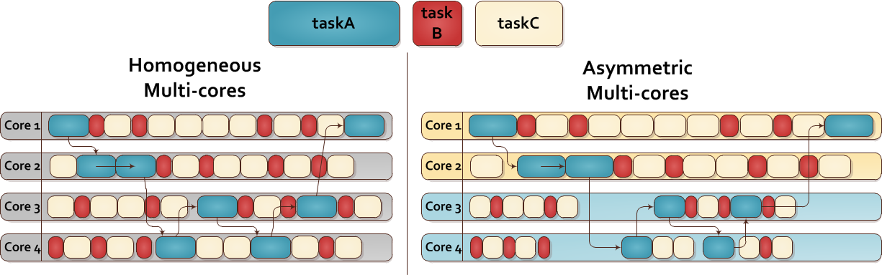
Moving from Homogeneous to Asymmetric Multi-cores
time
time
Performance gaps!

Slide 16
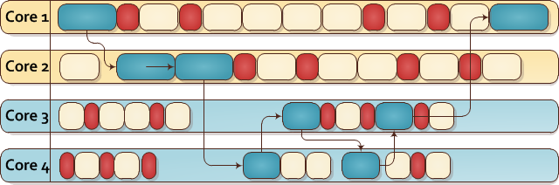
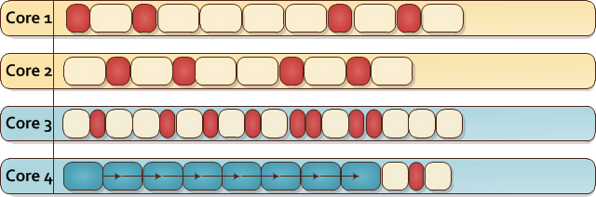
Scheduling is the solution
Scheduling!
Improvement

Slide 17
Challenges of Task-Based Programming Models
Asymmetry unaware
Scheduling can be improved
High task generation overheads

Slide 18
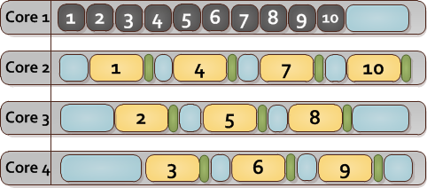
Task Generation Costs!
time

Slide 19
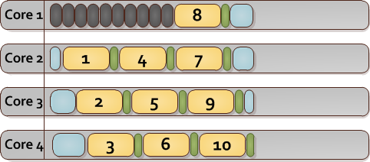
Accelerating Task Generation
Fast Task Generation
⇩ Improved Scheduling
Improvement

Slide 20
Scheduling Techniques
Scheduling!
Improvement

Slide 21
Scheduling Techniques
We develop 3 scheduling techniques
CATS: detects the longest path of the TDG
CPATH: detects the critical path of the TDG
HYBRID: detects either the longest or the critical path of the TDG depending on the current information
Notes:
TODO: Add info about TDG before this slide

Slide 22
CATS
CPATH
HYBRID

Slide 23
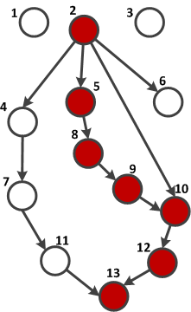
Criticality-Aware Task Scheduler (CATS)
Critical tasks:
The tasks that belong to the longest path of the task dependency graph (TDG)
Little Core
1
4
6
7
11
3
Scheduling!
Big Core
2
5
8
9
10
12
13
7

Slide 24
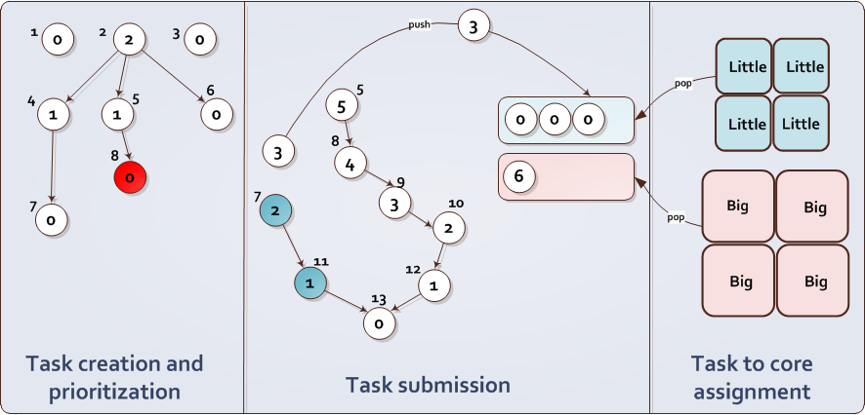
CATS Overview

Slide 25
CATS Overview

Slide 26

Task Prioritization (CATS)
Each task is prioritized by its bottom level
What is the bottom level?
The number of edges in a longest path from a task to the bottom of the graph

Slide 27
Task Prioritization (CATS)
1
2
3
Task id | Plist | priority
1 | { Ø } | 0
2 | { Ø } | 2
3 | { Ø } | 0
4 | { 2 } | 1
5 | { 2 } | 1
6 | { 2 } | 0
7 | { 4 } | 0
8 | { 5 } | 0
Task id | Plist | priority
1 | { Ø } | 0
2 | { Ø } | 2
3 | { Ø } | 0
4 | { 2 } | 1
5 | { 2 } | 0
6 | { 2 } | 0
7 | { 4 } | 0
8 | { 5 } | 0
Task id | Plist | priority
1 | { Ø } | 0
2 | { Ø } | 2
3 | { Ø } | 0
4 | { 2 } | 1
5 | { 2 } | 1
6 | { 2 } | 0
7 | { 4 } | 0
8 | { 5 } | 0
9 | { Ø } | 0
Task id | Plist | priority
1 | { Ø } | 0
2 | { Ø } | 2
3 | { Ø } | 0
4 | { 2 } | 1
5 | { 2 } | 1
6 | { 2 } | 0
7 | { 4 } | 0
8 | { 5 } | 0
9 | { 8 } | 0
Task id | Plist | priority
1 | { Ø } | 0
2 | { Ø } | 3
3 | { Ø } | 0
4 | { 2 } | 1
5 | { 2 } | 2
6 | { 2 } | 0
7 | { 4 } | 0
8 | { 5 } | 1
9 | { 8 } | 0
2
0
Task id | Plist | priority
1 | { Ø } | 0
2 | { Ø } | 2
3 | { Ø } | 0
4 | { 2 } | 1
5 | { 2 } | 0
6 | { 2 } | 0
7 | { 4 } | 0
8 | { Ø } | 0
0
3
4
1
5
6
0
0
1
2
8
7
1
0
9
0
0

Slide 28
CATS Overview

Slide 29

Task Submission (CATS)
1
2
3
maxPriority:
1
2
3
6
5
1
0
6
0
4
4
5
maxTaskSucc:
{ }
{ 4, 5, 6, 10 }
{ 8 }
{ 10 }
{ 12 }
{ 13 }
3
6
0
{ 9 }
5
8
7
4
Non-critical queue
2
9
3
10
Critical queue
11
2
1
1
12
13
0
Conditions
1. priorityOf(current) > maxPriority
2. priorityOf(current) == maxPriority-1 && current ∈ maxTaskSucc
☒
☑
☒
☑

Slide 30
Task Submission (CATS)
maxPriority:
1
2
3
6
5
Sorted queues according to the task priority
1
maxTaskSucc:
{ }
{ 4, 5, 6, 10 }
{ 8 }
{ 10 }
{ 12 }
{ 13 }
Non-critical queue
3
2
1
0
0
0
Critical queue
6
5
4
3
2
1
0
Conditions
1. priorityOf(current) > maxPriority
2. priorityOf(current) == maxPriority-1 && current ∈ maxTaskSucc
☒
☑

Slide 31
Flexibility and Strictness in Task Submission (CATS)
maxPriority:
1
2
2
3
3
1
6
0
0
maxTaskSucc:
{ }
{ 4, 5, 6, 10 }
{ 8 }
{ 10 }
4
3
5
6
0
5
8
7
4
2
9
Two CATS configurations
Strict: priorityOf(4) > maxPriority
Flexible: priorityOf(4) >= maxPriority
Result: flexible results with more critical tasks
3
10
11
2
1
1
12
13
0
Notes:
Move to backup?

Slide 32
CATS Overview

Slide 33
Task-to-Core Assignment
Little
Little
pop
Little
Little
Non-critical queue
3
2
1
0
0
0
Critical queue
6
5
4
3
2
1
0
Big
Big
work stealing
Optional: 2D work stealing
pop
Big
Big

Slide 34
CATS
CPATH
HYBRID

Slide 35
CPATH Scheduler
Online profiling:
Tracks the task execution time when a task finishes execution
Critical Tasks:
The tasks that belong to the critical path of the TDG

Slide 36
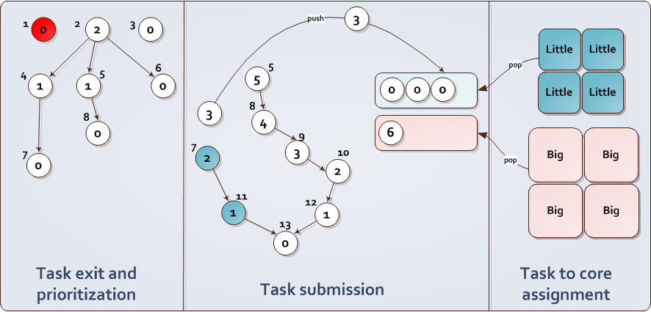
CPATH Overview
Same as CATS
Same as CATS

Slide 37
CPATH Overview
Same as CATS
Same as CATS

Slide 38
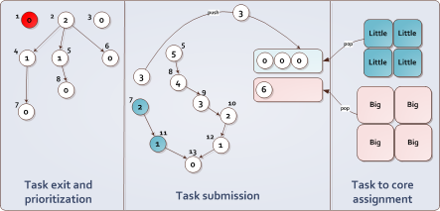
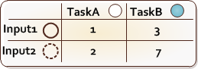
Task Prioritization (CPATH)
1
2
3
0
18
0
4
5
6
7
Task prioritization according to bottom cost
Wat is bottom cost?
The maximum estimated time in the dependency chains from this node to a leaf node
17
12
8
7
0
10
10
9
7
10
11
5
9
4
12
13
2

Slide 39
Task prioritization on task exit (CPATH)
✘
1
2
3
0
0
0
4
5
5
6
0
8
0
0
8
Task type – Input size (tt-is) | Task Cost
7
7
0
0
9
4
6
0
10
TaskA – Input2
2
0
11
5
3
0
0
12
4
13
2
0

Slide 40
CPATH Overview
Same as CATS
Same as CATS

Slide 41
Task Submission and Task-to-Core Assignment (CPATH)
Task Submission:
Identical to CATS but we have to keep track of maxExecTime
The execution time of the last critical task
Task-to-Core assignment:
Similar to CATS: big cores execute critical tasks and little cores execute non-critical tasks

Slide 42
CATS
CPATH
HYBRID

Slide 43
Hybrid Scheduler
Combination of CATS and CPATH
Prioritization during task creation
Task cost tracking during task exit
Uses task cost only if available
Task submission similar to CPATH

Slide 44
HYBRID Scheduler
Activity | CATS | CPATH | HYBRID
Task Prioritization | At creation time | At task exit | At creation time
Task cost tracking | - | At task exit | At task exit
Task submission | maxPriority-1 | maxPriority-1 or maxPrirority-maxExecTime | maxPriority-1 or maxPrirority-maxExecTime
Task-to-Core Assignment | The same

Slide 45
Evaluation of Scheduling Techniques

Slide 46
Evaluation Methodology
Part 1:
Evaluation of CATS configurations
Part 2:
Comparison of different scheduling techniques

Slide 47
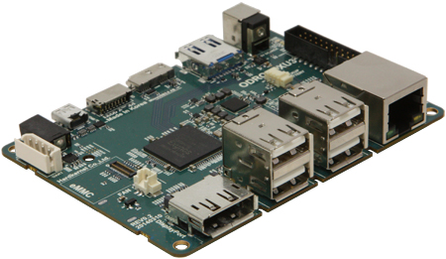
Platforms
ODROID XU3
8-core Samsung Exynos 5422
ARM big.LITTLE architecture
4 x Cortex-A15 cores at 2.0GHz (big)
4 x Cortex-A7 cores at 1.4GHz (little)
TaskSim Simulator
Larger systems
Different performance ratios of big and little (2× to 4×)

Slide 48
Evaluation Methodology
Part 1:
Evaluation of CATS configurations
Part 2:
Comparison of different scheduling techniques

Slide 49
Evaluation of CATS configurations
Scheduler | Comments
CATS SS FLEX | Simple work stealing and flexible
CATS SS STRICT | Simple work stealing and strict
CATS 2DS FLEX | Bidirectional work stealing and flexible
CATS 2DS STRICT | Bidirectional work stealing and strict
BF | OmpSs default random FIFO scheduler
Kernel | #Tasks | Measured Perf. Ratio | % Critical tasks
Cholesky 8x8 | 120 | 2.23 | 17.5
Cholesky 16x16 | 816 |  | 5.5
Integral Histogram | 2048 | 1.71 | 7.3
QR | 1,496 | 4.26 | 4.4
Heat diffusion | 5,124 | 2.83 | 4.1

Slide 50
Average Results
SS FLEX is the most efficient
Up to 17% average improvement for 8 cores
It allows more tasks for big cores (FLEX)
2DS stealing randomizes the scheduling
little cores get access to critical tasks

Slide 51

Cholesky
AA
Improvement up to 30%
SS FLEX configuration best
8x8
16x16
Improvement up to 9%
SS FLEX configuration best

Slide 52
Evaluation Methodology
Part 1:
Evaluation of CATS configurations
Part 2:
Comparison of different scheduling techniques

Slide 53
Evaluation of All Schedulers
CATS
CPATH
HYBRID
dHEFT
Dynamic implementation of state-of-the-art Heterogeneous Earliest Finish Time Scheduler [1]
BF
[1] H. Topcuoglu et al. Performance-Effective and Low-Complexity Task Scheduling for Heterogeneous Computing

Slide 54
Evaluation of All Schedulers
Evaluated Schedulers
CATS
CPATH
HYBRID
dHEFT
BF
Kernel | #Tasks | Measured Perf. Ratio | #Task types
Cholesky 8x8 | 120 | 2.23 | 4
Cholesky 16x16 | 816
QR | 1,496 | 4.26 | 4
Heat diffusion | 5,124 | 2.83 | 3
Integral Histogram | 2,048 | 1.71 | 2
Bodytrack | 408,525 | 4.14 | 6

Slide 55
Performance on 8 cores
17%
15%
6%
11%
38%
30%
CATS and HYBRID outperform the other approaches due to their reduced overheads
CPATH: reduced performance but still outperforms BF

Slide 56
Average performance
Heterogeneous schedulers improve the baseline BF scheduler by up to 16% on average
CATS and HYBRID show similar results
CPATH is less effective due to the additional overheads (up to 5% improvement)

Slide 57
Average Simulation Results
TaskSim trace-driven simulator
The benefits of CATS and HYBRID increase as we increase the number of cores

Slide 58
Scheduling Techniques Conclusions
The shape of the TDG plays an important role on scheduling
CATS handles TDGs with higher percentage of critical tasks more efficiently
Having an accurate critical path is not the most efficient
K. Chronaki et.al.
Cricitality-Aware Dynamic Task Scheduler for Heterogeneous Architectures, in ICS 2015
Task Scheduling Techniques for Asymmetric Multi-Core Systems, in TPDS 2016

Slide 59
TaskGenX
Fast Task Generation
⇩ Improved Scheduling
Improvement

Slide 60
Task-Based Programming Models
Compiler:
Translation of task annotations
Runtime system:
A set of SW threads
Master thread + workers
1 thread per core (pinned)
These threads perform:
Task Execution
Task Creation
Task Scheduling
Dependence analysis
void foo(int x, int y) { … } int main() { for(int i = 0; i <10; i++) for(int j = 0; j<10; j++) #pragma omp task in(i) out(j) foo(i, j); #pragma omp taskwait return 0; }
Multi-core System
…
…

Slide 61
Task-Based Programming Models
High task generation overheads
Task generation becomes more critical as we increase the number of cores
96%
54%
28%
15%
8%

Slide 62
Our Solution: TaskGenX
A HW-SW proposal to overcome task creation overheads in task-based runtime systems
TaskGenX consists of:
A task-based runtime system with dependence analysis
A specialized hardware for task creation
TaskGenX decouples task creation from the other runtime activities and executes it on the Runtime Optimized core (RTopt)
TaskGenX
Task-Based Runtime System
RTopt

Slide 63
TaskGenX
Task-Based Runtime System
RTopt
63

Slide 64
TaskGenX Runtime System
Master & Worker Threads
Special Runtime Thread
TaskGenX creates one extra SW thread, the Special Runtime Thread (SRT)
push task
pop task
TASKQ: the runtime system maintains this queue to store the tasks that are ready for execution
TASKQ
push work
pop work
A Runtime Request Queue (RRQ) is used to store task-creation work units
Master and/or worker threads push work to the RRQ
RRQ
SRT pops work units and executes them

Slide 65
TaskGenX
Task-Based Runtime System
RTopt

Slide 66
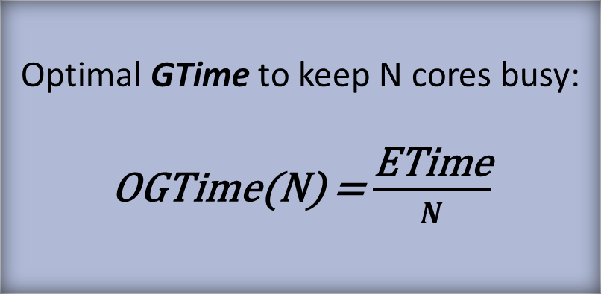
RTopt Requirements
Analysis based on Etsion et.al. for the optimal utilization of the SoC
Task Generation rate > Task Execution rate
1 core for tasks | Task Generation Time < task Execution Time GTime ≤ ETime
N cores for tasks | N × GTime ≤ ETime
Optimal GTime to keep N cores busy: OGTime(N) = $\frac{\text{ETime}}{N}$
Core 1
1
2
3
4
5
6
7
8
9
10
Core 2
1
4
7
10
Core 3
2
5
8
Core 4
3
6
9
Task Generation
Runtime
Task Execution
[1] Y. Etsion et.al. “Task-superscalar: An out-of-order task pipeline”, MICRO’2010

Slide 67
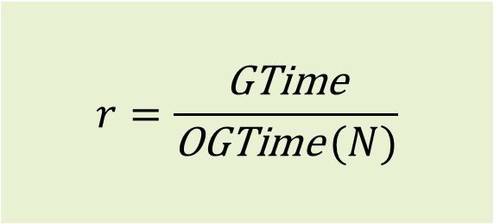
Reducing GTime for optimal SoC utilization
Question: How much faster should RTopt execute task generation compared to a general purpose core?
TaskGen Ratio:
RTopt should perform task generation r times faster than a general purpose core
Different r for each application
Depends on the average task time of the application
$$r=\frac{\text{GTime}}{\text{OGTime} (N)}$$

Slide 68
Evaluation

Slide 69
Experimental Methodology
11 OpenMP workloads from BSC Application Repository [1] and PARSECSs benchmark suite [2]
Input sizes chosen so that there are enough tasks for up to 512 cores
Modified version of TaskSim [3] simulator:
Features one RTopt per multi-core
Simulation of duration of runtime overheads:
Task creation, dependence analysis, scheduling
Symmetric and Asymmetric general purpose systems
[1] BSC Application Repository https://pm.bsc.es/projects/bar
[2] D. Chasapis et.al. “PARSECSs: Evaluating the Impact of Task Parallelism in the PARSEC Benchmark Suite”, TACO ‘15
[3] A. Rico et.al. “On the Simulation of Large-Scale Architectures Using Multiple Application Abstraction Levels”, TACO ‘12

Slide 70
Experimental Methodology
Workload | #Tasks | Avg task CPU Cycles (thousands) | Per-Task Generation CPU Cycles | r
Cholesky256 | 357762 | 753 | 15221 | 10.34
Cholesky128 | 2829058 | 110 | 17992 | 83.74
QR512 | 11442 | 518570 | 17595 | 0.01
QR128 | 707265 | 3558 | 21642 | 3.11
Blackscholes | 488202 | 348 | 29141 | 42.87
Bodytrack | 329123 | 383 | 9505 | 12.70
Canneal | 3072002 | 67 | 25781 | 197.01
Dedup | 20248 | 1532 | 1294 | 0.43
Ferret | 84002 | 29088 | 38913 | 0.68
Fluidanimate | 128502 | 16734 | 30210 | 0.91
Streamcluster | 3184654 | 161 | 6892 | 21.91
Range of r: [0.01x – 197x) Use of r = 16x (relatively low realistic value among the observed ones)

Slide 71
Evaluation
We compare two different runtime systems:
Nanos: The Nanos++ runtime system running on x cores
TaskGenX: our proposed runtime system that takes advantage of RTopt

Slide 72
Evaluation – Apps with low benefit (r<1)
Workload | #Tasks | Avg task CPU Cycles (thousands) | Per-Task Generation CPU Cycles | r
Cholesky256 | 357762 | 753 | 15221 | 10.34
Cholesky128 | 2829058 | 110 | 17992 | 83.74
QR512 | 11442 | 518570 | 17595 | 0.01
QR128 | 707265 | 3558 | 21642 | 3.11
Blackscholes | 488202 | 348 | 29141 | 42.87
Bodytrack | 329123 | 383 | 9505 | 12.70
Canneal | 3072002 | 67 | 25781 | 197.01
Dedup | 20248 | 1532 | 1294 | 0.43
Ferret | 84002 | 29088 | 38913 | 0.68
Fluidanimate | 128502 | 16734 | 30210 | 0.91
Streamcluster | 3184654 | 161 | 6892 | 21.91

Slide 73
Workloads with Low Benefit (r<1)
Applications with low task generation time compared to task time
Same average performance

Slide 74
Evaluation – Apps with high benefit
Workload | #Tasks | Avg task CPU Cycles (thousands) | Per-Task Generation CPU Cycles | r
Cholesky256 | 357762 | 753 | 15221 | 10.34
Cholesky128 | 2829058 | 110 | 17992 | 83.74
QR512 | 11442 | 518570 | 17595 | 0.01
QR128 | 707265 | 3558 | 21642 | 3.11
Blackscholes | 488202 | 348 | 29141 | 42.87
Bodytrack | 329123 | 383 | 9505 | 12.70
Canneal | 3072002 | 67 | 25781 | 197.01
Dedup | 20248 | 1532 | 1294 | 0.43
Ferret | 84002 | 29088 | 38913 | 0.68
Fluidanimate | 128502 | 16734 | 30210 | 0.91
Streamcluster | 3184654 | 161 | 6892 | 21.91

Slide 75
High Benefit Workloads
Up to 16×
Up to 15×
Up to 8×
Up to 15×
Up to 14×
Applications with high task generation time compared to task time
7x faster on average

Slide 76
Evaluation – Canneal
Workload | #Tasks | Avg task CPU Cycles (thousands) | Per-Task Generation CPU Cycles | r
Cholesky256 | 357762 | 753 | 15221 | 10.34
Cholesky128 | 2829058 | 110 | 17992 | 83.74
QR512 | 11442 | 518570 | 17595 | 0.01
QR128 | 707265 | 3558 | 21642 | 3.11
Blackscholes | 488202 | 348 | 29141 | 42.87
Bodytrack | 329123 | 383 | 9505 | 12.70
Canneal | 3072002 | 67 | 25781 | 197.01
Dedup | 20248 | 1532 | 1294 | 0.43
Ferret | 84002 | 29088 | 38913 | 0.68
Fluidanimate | 128502 | 16734 | 30210 | 0.91
Streamcluster | 3184654 | 161 | 6892 | 21.91

Slide 77
Canneal
Using r = 16: performance saturates on 64 cores 14× improvement
For this app r = 197
Increasing r increases performance

Slide 78
Asymmetric Multi-Core Systems

Slide 79
Asymmetric Multi-Core Systems
Up to 86%
Up to 3.7x
Moving the master thread from a big to a slow core degrades performance due to slower task generation
TaskGenX offers portability for asymmetric systems
Does not matter the type of core that master thread executes

Slide 80
Comparison to Other approaches
Deps | Scheduling Dependence analysis | Picos++, Nexus#
Runtime | Task Creation Scheduling Dependence analysis | Carbon, TaskSS
TaskGenX | Task Creation | TaskGenX

Slide 81
TaskGenX Conclusions
Task generation is a significant bottleneck of parallel runtimes
Most applications benefit from TaskGenX
Up to 3x average improvement for homogeneous systems
Up to 3.7x average improvement on asymmetric systems
Portable solution
Minimalistic and effective compared to other approaches
K. Chronaki et.al.
TaskGenX: A Hardware-Software Proposal for Accelerating Task Parallelism, in ISC 2018

Slide 82
Thesis Insights and Future Directions

Slide 83
Thesis Insights
AMC is a promising architecture for HPC
Scheduling needs to be sophisticated and with low overheads
Complex scheduling policies are not always the best solution (CATS vs CPATH)
The shape of the TDG of every application is a critical characteristic to performance and scheduling
Task creation is a very important overhead that should be studied and accelerated

Slide 84
Future Directions
Adapt current schedulers to systems with three (or more) levels of asymmetry
Provide a super-scheduler that adapts the appropriate scheduling policy according to application’s characteristics
Combine TaskGenX with asymmety-aware schedulers*
Hardware design of task generation accelerator
*work in progress

Slide 85
Exploiting Asymmetric Multi-Core Systems with Flexible System Software
Kallia Chronaki
Thesis Advisors: Rosa M. Badia Marc Casas
July 2018
PhD Thesis Defense

Slide 86
Back up slides

Slide 87
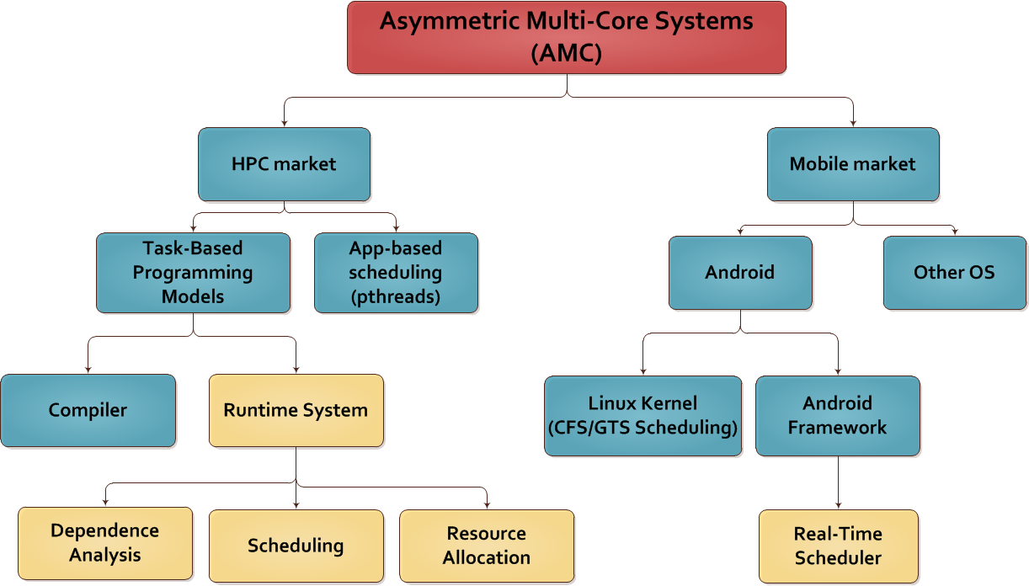
Asymmetric Multi-Core Systems

Slide 88
Power Results

Slide 89
Thesis Contributions
CATS
TPDS
ISC
PARSEC JPDC | Under review
PARSEC PACT poster

Slide 90
Scheduling

Slide 91
Task Submission (CATS)
1
2
3
maxPriority:
1
2
3
6
5
1
0
6
0
4
4
5
maxTaskSucc:
{ }
{ 4, 5, 6, 10 }
{ 8 }
{ 10 }
{ 12 }
{ 13 }
3
6
0
{ 9 }
5
8
7
4
Non-critical queue
2
9
3
10
Critical queue
11
2
1
1
12
13
0
Conditions
1. priorityOf(current) > maxPriority
2. priorityOf(current) == maxPriority-1 && current ∈ maxTaskSucc
☒
☑
☒
☑

Slide 92
Integral Histogram
Improvement up to 15%
SS FLEX is the winner!
A few exceptions for unbalanced systems (4little – 1big)
CATS improves according to critical tasks %
Kernel | #Tasks | Measured Perf. Ratio | % Critical tasks
Cholesky 8x8 | 120 | 2.23 | 17.5
Cholesky 16x16 | 816 |  | 5.5
Integral Histogram | 2048 | 1.71 | 7.3

Slide 93
Double precision benchmarks: QR and Heat Diffusion
Improvement up to 20%
SS FLEX is the winner
Heat – higher improvement for balanced systems
QR
Heat
Kernel | #Tasks | Measured Perf. Ratio
QR | 1496 | 4.26
Heat diffusion | 5124 | 2.83

Slide 94
Task Cost Distributions
Notes:
`

Slide 95
Simulation Results
TaskSim trace-driven simulator
The benefits of CATS and HYBRID increase as we increase the number of cores

Slide 96
TaskGenX

Slide 97
Accelerating Task Generation
Fast Task Generation
⇩ Improved Scheduling
Improvement

Slide 98
TaskGenX Runtime System
void foo(int x, int y) { … } int main() { … #pragma omp task in(i) out(j) foo(i, j); … #pragma omp taskwait return 0; }
The compiler translates the task1 invocation to createTask call
Instead of creating the task, TaskGenX inserts a work unit in the RRQ
//Master and Worker threads loop: while( not TASKQ.empty() ) { execute( TASKQ.pop() ); } //SRT loop: while( not RRQ.empty() ) { work w = RRQ.pop(); execute( w ); }
createTask(foo, i, j);
int main() { … createTask(task1, i, j); … waitUntilAllTasksDone(); return 0; }
void createTask(task1, i, j) { work w(foo, i, j); RRQ.push( w ); }
All threads iterate over their loops that provide them the work/task to execute until the application is finished
TaskGenX is implemented in Nanos++ runtime system[1] that serves as the OpenMP runtime
[1]Barcelona Supercomputing Center. Nanos++ https://pm.bsc.es/nanox

Slide 99
Too much information!
Cholesky 8×8
Cholesky 16×16
QR

Slide 100
Comparison to Other approaches
Deps: acceleration of dependence analysis + scheduling occurred like Picos++, Nexus#
Runtime: acceleration of scheduling, dependence analysis and task creation like Carbon, TaskSS
TaskGenX: acceleration of task creation only

Slide 101
Comparison to Other approaches
Deps: serialization of parallel parts of the runtime
Runtime: benefits on limited number of cores due to task creation acceleration
TaskGenX: acceleration of task creation while running other runtime activities in parallel

Slide 102

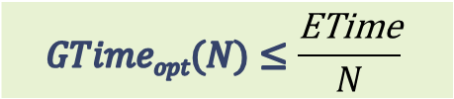
Reducing GTime for optimal SoC utilization
GTime | Actual task generation time on a general purpose core
GTime_{opt}(N) | Optimal task generation time in order to keep N cores busy
ETime | Average task execution time
Question: How much faster should RTopt execute task generation compared to a general purpose core?
RTopt should perform task generation r times faster than a general purpose core
For each application we observe different r values as they depend on the average task time of the application
The r values observed in our workloads range from 0.01 to 197
$$GTimeopt(N)≤\frac{\text{ETime}}{N}$$
$$r=\frac{\text{GTime}}{\text{GTime}opt (N)}$$

Slide 103
Evaluation of All Schedulers
Kernel | #Tasks | Measured Perf. Ratio | #Task types
Cholesky 8x8 | 120 | 2.23 | 4
Cholesky 16x16 | 816
QR | 1,496 | 4.26 | 4
Heat diffusion | 5,124 | 2.83 | 3
Integral Histogram | 2,048 | 1.71 | 2
Bodytrack | 408,525 | 4.14 | 6
Evaluated Schedulers
CATS
CPATH
HYBRID
dHEFT
BF
Real Machine
Octa-core Arm big.LITTLE (4 big + 4 little cores)
Simulation
TaskSim trace driven simulator

Slide 104
Evaluation – part 1
Kernel | #Tasks | Measured Perf. Ratio | % Critical tasks
Cholesky 8x8 | 120 | 2.23 | 17.5
Cholesky 16x16 | 816 |  | 5.5
Integral Histogram | 2048 | 1.71 | 7.3
QR | 1,496 | 4.26 | 4.4
Heat diffusion | 5,124 | 2.83 | 4.1

